Slide 1
WEB APPLICATION DEVELOPMENT TRAINING
LECTURE SLIDES ON
DATABASE DESIGN AND MODELING

Slide 2
Steps in Designing a Database
Database design is the process of producing a detailed data model of database
Decide on what data to store in the database
Determine the categories of related data and create tables accordingly. Each table should contain ONLY related data
For each column in the table, determine the appropriate data type.
Each table should contain a field that is unique to each record in the table
Exercise: create a database for the customer registration and product information aspect of an ecommerce website . Design the database in such a way that customers can search for items by product name and also by category

Slide 3
Logical Representation of a Database
The process of logical design involves arranging data into a series of logical relationships called entities and attributes
An entity relationship model, also called an entity-relationship (ER) diagram, is a graphical representation of entities and their relationships to each other, typically used in computing in regard to the organization of data within databases or information systems.

Slide 4
Database Entity
An entity is any object in the system that we want to model and store information about.
Entities are usually recognizable concepts, either concrete or abstract, such as customer, products which have relevance to the E-commerce website database.

Slide 5
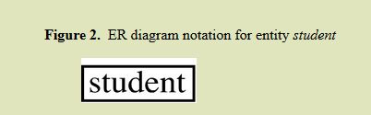
Logical Database Design Using Entity Relationship Diagram
You can design/model your database [tables] using Entity Relationship Diagram where the tables represent the entity you are modeling.
Each entity has attributes, or particular properties that describe the entity.
For example, student Emanuel has properties of his own Student Identification number

Slide 6
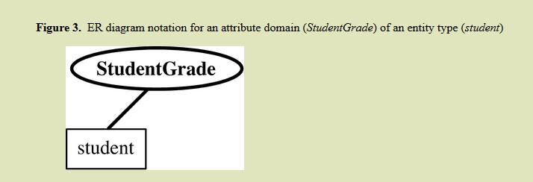
Logical Database Design Using Entity Relationship Diagram
The attributes of the entities are the columns of the database tables and are represented by ovals that connect to the entity

Slide 7
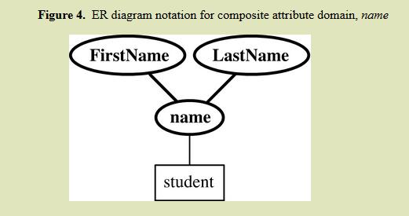
Logical Database Design Using Entity Relationship Diagram
A composite attribute is one that can have more than one part eg name can be first name and surname

Slide 8
Logical Database Design Using Entity Relationship Diagram
An attribute or set of attributes that uniquely identifies a particular entity is a key. For example, Emanuel‘s Student Identification Number uniquely identifies him
This attribute is underlined to show that It is the key attribute
Relationship: A relationship type is a set of associations among entity types.
For Example, relationship exists between student entity and Lecturer entity

Slide 9
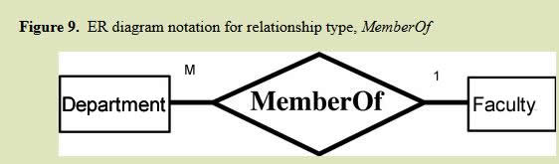
Logical Database Design Using Entity Relationship Diagram
The relationship can be one to many or many to many or one to one (If One person has only one passport – ONE to ONE)
Eg A faculty can have many departments while a department can only have one faculty. The relationship is known as one to many
Relationship is shown using a diamond shape:

Slide 10
Exercise
As the IT consultant to Opebi University, you have recommended to the development team that they should create a form where new departments can be added to the system as they are being accredited by the NUC.
Based on the ER diagram in the previous slide and the many-to-one relationship between department and Faculty, which of the following form designs can be adopted?

Slide 11
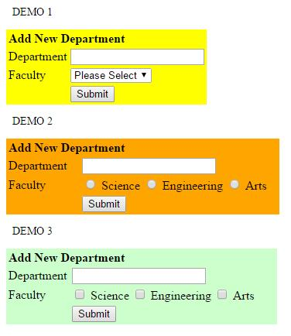

Slide 12
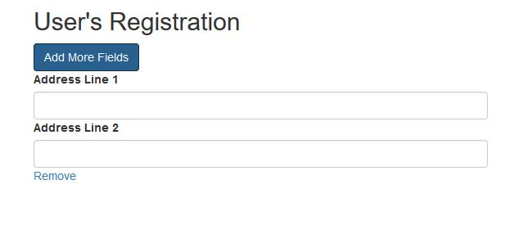
How would you design the table below to capture address?

Slide 13
Exercise
The role of the President is currently vacant at Lagos State Association of Chemical Engineers.
Only members who have paid their dues can vote
There are 3 contestants but there will only be one winner.
Identify the entities in the proposed e voting system for this association.
Notes:
Suggested entities; members, contestants (stores data abt the contestants like manitesto, this table will link to member table), payment
Vote is the relationship between member and the contestant.
Ponder: a member can vote for a contestant

Slide 14
Creating Tables From Entity
Create table for each entity.
The attributes of the entity will serve as the fields of the tables with their respective data types.
Declare primary key.

Slide 15
Creating Tables From Relationship
If you have decided that you want to store some things about the relationship, create table for the relationship.
Add the primary keys of all participating Entities as fields of table with their respective data types.
If relationship has any attribute, add each attribute as field of table.
Declare a primary key composing all the primary keys of participating entities.
Declare all foreign key constraints.

Slide 16
Exercise
At a project meeting, the client has told you that he will like a platform where people can upload their picture and choose from a wide range of template to be used in the picture frame. Describe possible entities and the relationships
Notes:
Users, template – the relationship between the two tables is edit, a user can edit a frame. If you are interested in saving some information about this relationship (editing of frame) you can create a table template_edit. The table must have the user_id and the id of the template being edited in order to be meaningful.

Slide 17
Weak Entity
A weak entity is one which does not have any primary key associated with it.
Example: Ab & M Ltd uses UBA and GTB respectively. They operate both Savings and Current account at GTB each with different numbers. They are also considering opening a second one at UBA
What is the best way to design the database tables that will be used in the above given that they have only 2 account officer one in each banks managing all the diff accounts?
Notes:
Example of weak entity here is the bank_details table. What do you notice about this entity? It cannot be fully identified by its own attributes. Cannot have a primary key of its own therefore, it must use a foreign key in conjunction with its attributes to create a primary key. The foreign key is typically a primary key of an entityit is related to.

Slide 18
Weak Entity
Example of weak entity here is the bank_details table.
What do you notice about this entity?
It cannot be fully identified by its own attributes. Cannot have a primary key of its own therefore, it must use a foreign key in conjunction with its attributes to create a primary key.
The foreign key is typically a primary key of an entity it is related to.
The order table and order detail table

Slide 19
Database Schema
Having designed the database based on the entities and their relationship in what is known as E-R diagram, the next step is to design the database schema.
The database schema shows the organization of the tables in the database, their relationship and details such as the column name, the data type – It simply is the blueprint of how your database is organized.
See the example below:

Slide 20
Assignment
Design a database for a late-comer app. It should capture the profile of all the participants in the class.
Participants should login when they come every day, anyone who login after 9am is assumed to be late and will be due to pay 500 naira as fine.
At the end of the programme, we should be able to see all the total amount raised and know how much each person owes
We will have a small party with the money raised.

Slide 21
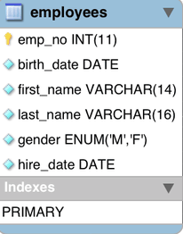
Database Schema
There are tools you can use to create database schema
Example is: Microsoft Visio,
Others are:
http://www.dbschema.com/
Visual Paradigm etc

Slide 22
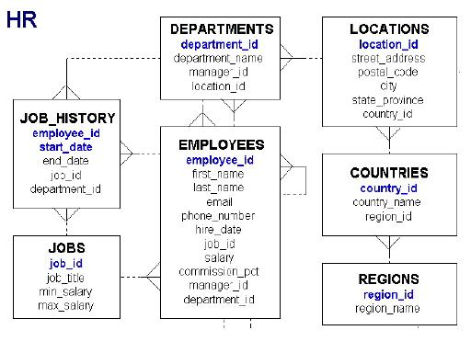
Notes:
Database Schema for an HR department of a company explained

Slide 23
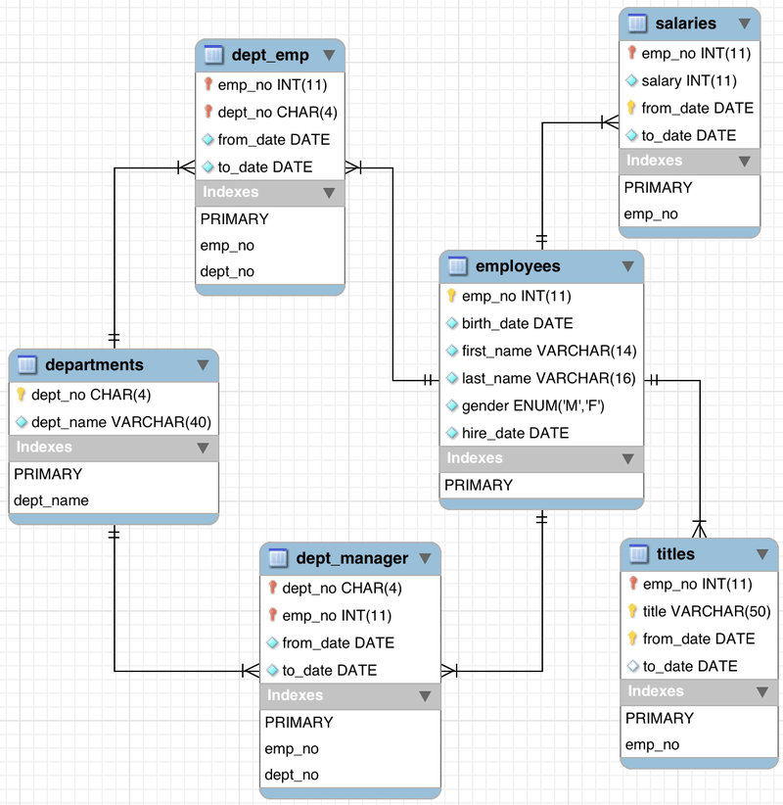
A more detailed database schema for employee records

Slide 24
Physical Design
After the database has been modeled using ER Diagram and the database schema has been designed. The next is the creation of the Physical Database
Physical database design translates the logical data model into a set of SQL statements that define the database.
In relational Database System, entities simply become tables
When you create tables, you can set an auto increment field/column
You can set a Unique constraint to ensure that the column defines the uniqueness of the records being inserted.

